Slide 1

Prototype Presentation
Divvy Van Assistant Software
CS 440 - Introduction to Software Engineering
Group22 - Fall 2022
Prajwal Athreya , Sachin Srinivas , Aliasgar Merchant , Arjjun Prasaad

Slide 2
Disclaimer
All the materials with reference to the Divvy company is only used for the purpose of this project.Logo used in the ppt slides is the sole property of Divvy company and we do not wish to monetize or generate any sort of income from these powerpoint presentations or from any material owned by Divvy Company.We just hope to portray our work (Assistant software for the Divvy maintenance van) as a part of our implementation project for this semester.
Also we wish to give credits to the team that came up with this idea for their development project during the previous semester.

Slide 3
About
Divvy Van Assistant is a GUI application for Divvy Van drivers.
Our application mainly aims to help them to transport divvy bikes and scooters from one station to another Station seamlessly while ensuring optimal travel routes.
The main idea is to build a system that will keep track of all the divvy stations and the bikes available at each station.
Our goal is to increase the efficiency of the entire system without affecting the day to day activities in and around the city.
Our application can be used by other companies with certain modifications but the core principle will remain the same.

Slide 4
Some Key Features
User friendly interface and easy navigation throughout the process.
Task Ranking based on priorities and other parameters.
Optimality and precise routes.
Supply Demand principle used for functioning of application.
Efficiency is the key goal.
Defining excess and deficit cases with respect to predefined conditions.
Real Time data updation.

Slide 5
Technology & Data Used
Python3 and its libraries.
MongoDB for the database.
PySimpleGUI and Tkinter library for Front end.
Pandas for cleaning the dataset.
Excel for computing the distance in miles.
UML for scenario Diagrams.
Scrum and Agile techniques for project management.
Jira Software as a Project management tool.
Github for version Control.
Divvy Bike Data (Public Domain Access).

Slide 6
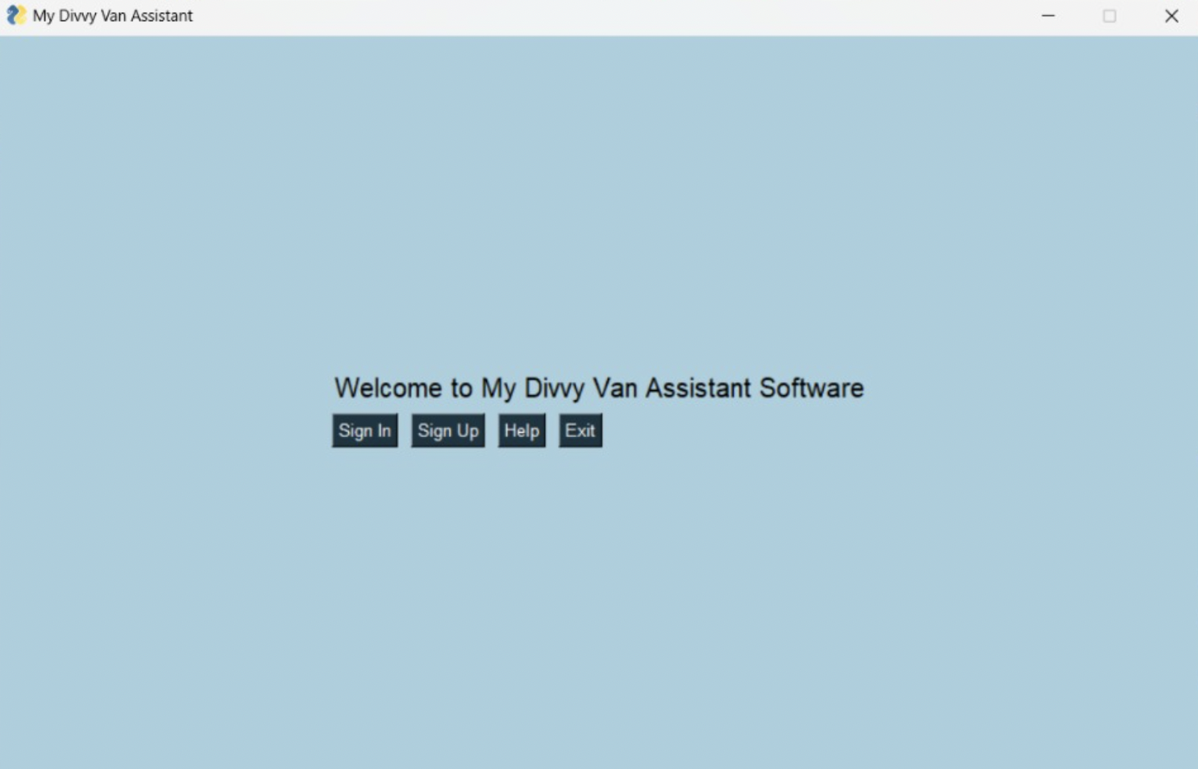
GUI (Graphical User Interface)

Slide 7
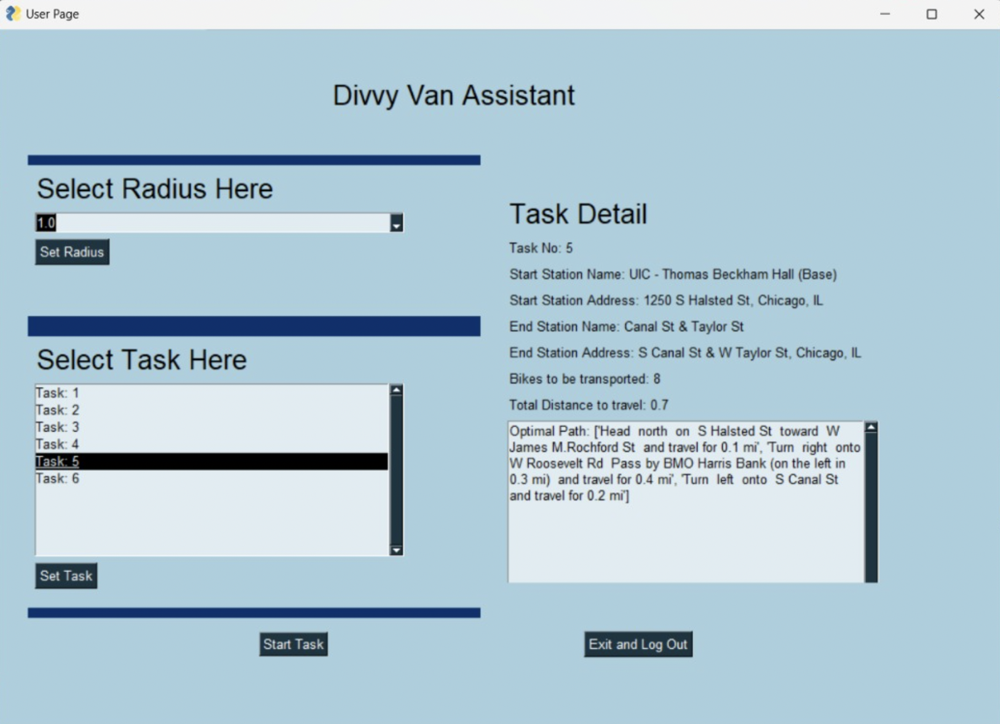
Available Tasks displayed in our GUI

Slide 8
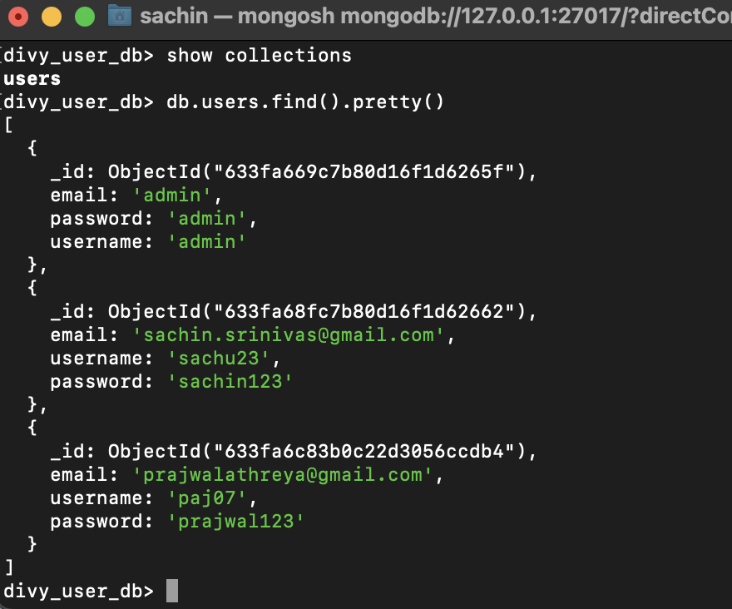
Database : MongoDB
Database populated with the user accounts

Slide 9
Task Ranking
We have created a task class which will be the main function for the computation of parameters to rank the different tasks available.
Parameters used for ranking the available jobs:
Excess and deficit of Divvy bikes at a particular Station.
Once the tasks are Ranked, the divvy Driver will be able to start the job by selecting one from the tasks displayed according to the priority.
If job is completed successfully, the tasks are updated in the interface and the same process is repeated.

Slide 10
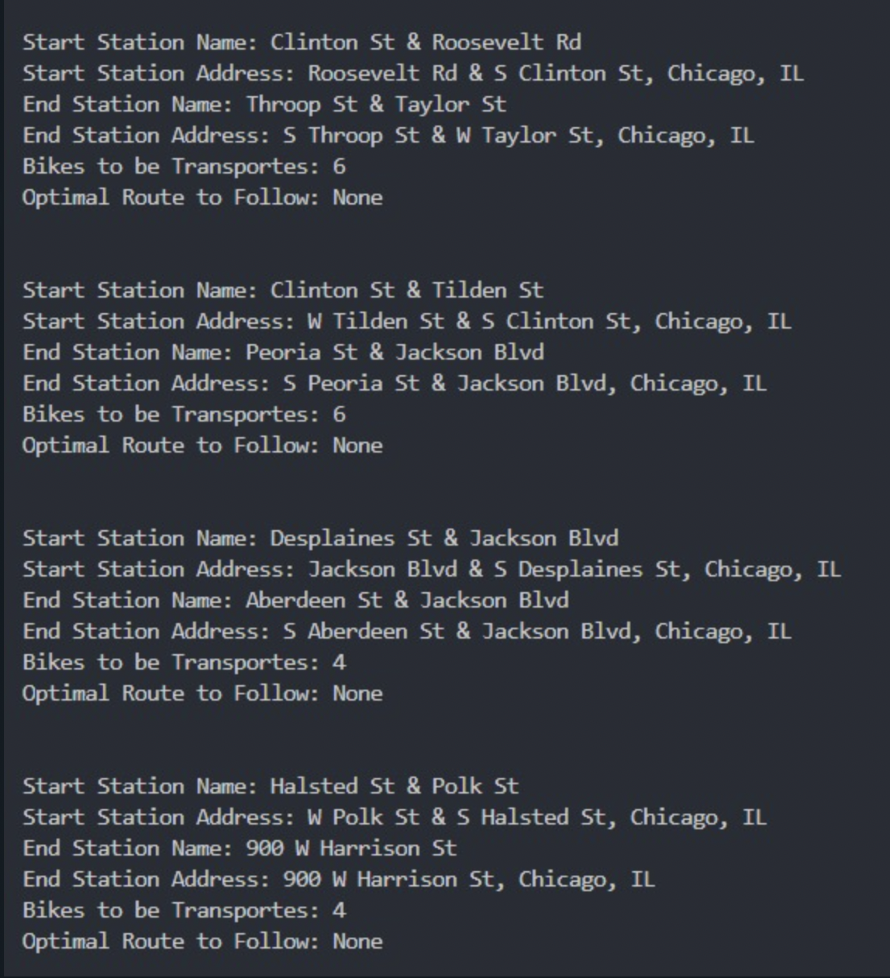
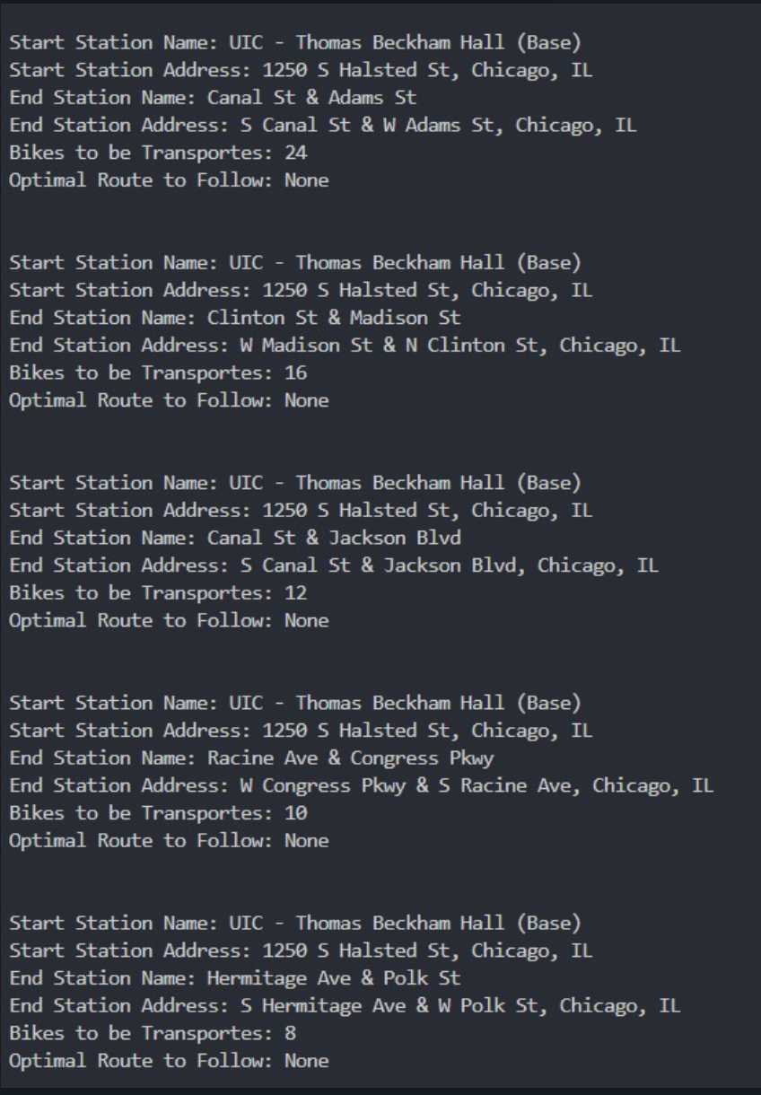
Task Ranking
Example denoting the user is starting from base with selected radius of 1 mile

Slide 11
Assumptions
Driver always starts from the Center reference location i.e UIC.
Application currently designed only for a radius of 5 miles with UIC as center.
Works on the principle of Supply & Demand.
If job is completed successfully, the tasks are then updated in the interface and the same process is repeated.
All the bikes are not in use at a certain time t.
Criteria for Excess and Deficit :
Excess if num of bikes >= 60% of the total docks at a particular station.
Deficit if num of bikes< 40% of the total docks at a particular station.

Slide 12
Thank You!

